Slide 1
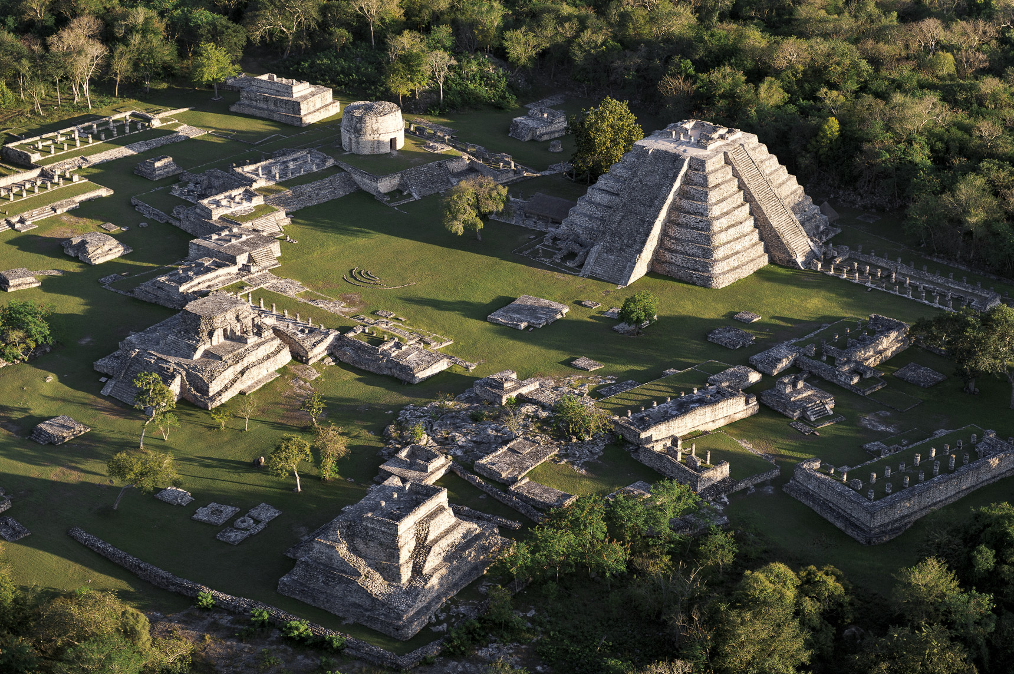
The Ancient Maya Civilization
Notes:
References:
Image source: Walled city of Mayapán, digital photograph, Yucatan, accessed March 22, 2023 <https://yucatan.travel/en/archeological-area/mayapan/>

Slide 2
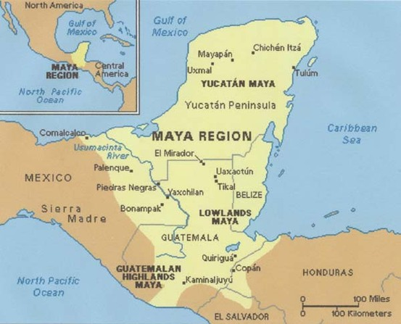
From approximately 1800 B.C. to 1050 A.D., the Maya civilization was one of Mesoamerica's most dominant indigenous societies. Located south of modern-day Mexico and north of modern-day South America, the Maya utilized both agricultural techniques and hunter-gatherer techniques and were centred around the Gulf of Mexico and the Caribbean Sea.
Notes:
Image source: Classical Mayan Period 2016, digital image, Human History In Brief, accessed March 22, 2023, <http://www.humanhistoryinbrief.net/2016/11/>
<References inserted here>

Slide 3

The Maya lived in three areas with distinct cultural and environmental differences, the first of which was The Northern Maya Lowlands. They were located primarily in the Yucatán Peninsula, near the Yucatán Maya, marked on the map in a red circle.
Notes:
Image source: Classical Mayan Period 2016, digital image, Human History In Brief, accessed March 22, 2023, <http://www.humanhistoryinbrief.net/2016/11/>

Slide 4
The next area is known as the Southern Lowlands, mainly in the Peten district of northern Guatemala and adjacent portions of Mexico, Belize and western Honduras, marked on the map in a blue circle.
Notes:
Image source: Classical Mayan Period 2016, digital image, Human History In Brief, accessed March 22, 2023, <http://www.humanhistoryinbrief.net/2016/11/>

Slide 5
The third and final area, the Southern Highlands, was in the mountainous region of southern Guatemala, seen here in the black circle.
Notes:
Image source: Classical Mayan Period 2016, digital image, Human History In Brief, accessed March 22, 2023, <http://www.humanhistoryinbrief.net/2016/11/>

Slide 6
The Maya civilization occupied Mesoamerica in the three previously-mentioned areas in 3 distinct time periods:
The Preclassic Period (1800 B.C. – 250 A.D.).
During the Preclassic Period, the Maya civilization’s citizens began establishing themselves in Mesoamerica as a hybrid agricultural hunter-gatherer society. Additionally, the construction of cities, sites, and architectural works such as the Mayan pyramids began.
Notes:
References:
Jacob, G. (2023). Annotated bibliography. https://www.dropbox.com/s/lqleovu77hsa0zd/AnnotatedBibliography.pdf?dl=0

Slide 7
The Classic Period is when the Maya civilization was at its ‘prime’: ideal climate conditions and surplus resources led to population booms and the establishment of trading networks, alliances and military victories led to territorial expansion, and developments in cultural and religious beliefs. Additionally, because of the large population boom, the population of skilled workers increased dramatically, leading to the completion of many architectural and technological marvels in the fields of architecture, mathematics, linguistics, language, and astronomy.
The Preclassic Period (1800 B.C. – 250 A.D.).
The Classic Period (250 A.D. – 800 A.D.).
Notes:
References:
Jacob, G. (2023). Annotated bibliography. https://www.dropbox.com/s/lqleovu77hsa0zd/AnnotatedBibliography.pdf?dl=0

Slide 8
And lastly is the period on which this presentation will be mainly focusing: The Terminal Classic Period. Directly contrasting The Classic Period, The Terminal Classic Period was a period of sharp decline and eventual collapse of the Maya civilization. Many cities and sites were abandoned because of volcanic activity, poor climate conditions, military losses, or simple abandonment. Large-scale droughts devastated agriculture, local vegetation, and water reserves, and the loss of able workers straining the already waning available resources.
The Preclassic Period (1800 B.C. – 250 A.D.).
The Classic Period (250 A.D. – 800 A.D.).
The Terminal Classic Period (800 A.D. – 1050 A.D.).
The period I am focusing on is in bright red to stand out
Notes:
References:
Jacob, G. (2023). Annotated bibliography. https://www.dropbox.com/s/lqleovu77hsa0zd/AnnotatedBibliography.pdf?dl=0

Slide 9
And lastly is the period on which this documentary will be mainly focusing: The Terminal Classic Period. Directly contrasting The Classic Period, The Terminal Classic Period was a period of sharp decline and eventual collapse of the Maya civilization. Many cities and sites were abandoned because of volcanic activity, poor climate conditions, military losses, or simple abandonment. Large-scale droughts devastated agriculture, local vegetation, and water reserves, and the loss of able workers strained the already waning available resources.
The Terminal Classic Period (800 A.D. – 1050 A.D.).
Notes:
References:
Jacob, G. (2023). Annotated bibliography. https://www.dropbox.com/s/lqleovu77hsa0zd/AnnotatedBibliography.pdf?dl=0

Slide 10
Like many civilizations in Mesoamerica, the Mayans had a monarchy system to hierarchically organize society into six distinct groups: Kings and queens, council members and priests, nobles and elite warriors, merchants and craftsmen, commoners and workers, and lastly, slaves.
For our purposes, our discussion will mainly include only the highest and lowest levels of the monarchy. Specifically, only kings, priests, warriors, and commoners are relevant to our discussion.
Notes:
References:
Maya social structure information: http://www.historyshistories.com/maya-society.html
Jacob, G. (2023). Annotated bibliography. https://www.dropbox.com/s/lqleovu77hsa0zd/AnnotatedBibliography.pdf?dl=0

Slide 11
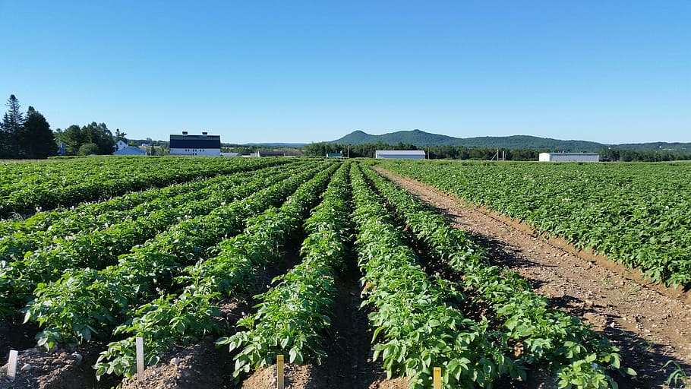
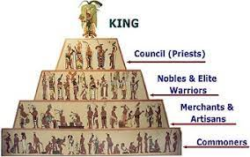
Before we elaborate more on what factors led to the collapse of the Mayan civilization, we must first discuss the characteristics of the Maya civilization. More specifically, we will discuss their social structure and agricultural practices.
Notes:
References:
Picture of crops: https://www.wallpaperflare.com/maine-potato-field-agriculture-crop-landscape-plant-food-and-drink-wallpaper-wbzzc
Maya social structure picture: http://www.historyshistories.com/the-maya.html

Slide 12
Like many civilizations in Mesoamerica at that time, the Mayans had a monarchy system to hierarchically organize society into six distinct groups: Kings, council members and priests, nobles and elite warriors, merchants and craftsmen, commoners and workers, and lastly, slaves.
Notes:
References:
Maya social structure picture: http://www.historyshistories.com/the-maya.html
Maya social structure information: http://www.historyshistories.com/maya-society.html

Slide 13
Although a monarchy system at its core, the Maya civilization had one noble family ruling over each city. The position of king was completely hereditary, meaning the son of a king could be the only individual appointed king. Larger cities often had kings which controlled smaller ones immediately around them. Because of their absolute power, kings were considered sacred ruler who was believed to a descendant of a god. Eventually, the king was replaced if there was evidence that they lost favour with the gods.
Notes:
References:
Maya social structure picture: http://www.historyshistories.com/the-maya.html
Maya social structure information: http://www.historyshistories.com/maya-society.html

Slide 14
At the bottom of the hierarchy were the commoners, equivalent to lower- or working-class people of today. Because the Maya civilization depended so heavily on agriculture for food and trade, commoners were farmers for the entirety of the growing season, and builders of pyramids and other city structures otherwise. *Continue talk about commoners, warriors, regardless of social rank, what diet mainly consisted of, and how droughts and unfavourable climate conditions lead to the death of many commoners and farms*
Notes:
References:
Maya social structure picture: http://www.historyshistories.com/the-maya.html
Maya social structure information: http://www.historyshistories.com/maya-society.html

Slide 15
Immediately below kings were council members and priests. Because religion was well-grounded in Maya activities, priests were behind only kings in their social rankings, and considered the keepers of knowledge, those who were highly educated in religion, linguistics, mathematics, astronomy, astrology, and history. More importantly, they studied the complex Maya calendar and advised on when to plant crops for optimal harvest. Priests hosted regular religious ceremonies, with offerings or even a sacrifice, to communicate with the gods and interpret the gods’ will.
Notes:
References:
Maya social structure picture: http://www.historyshistories.com/the-maya.html
Maya social structure information: http://www.historyshistories.com/maya-society.html

Slide 16
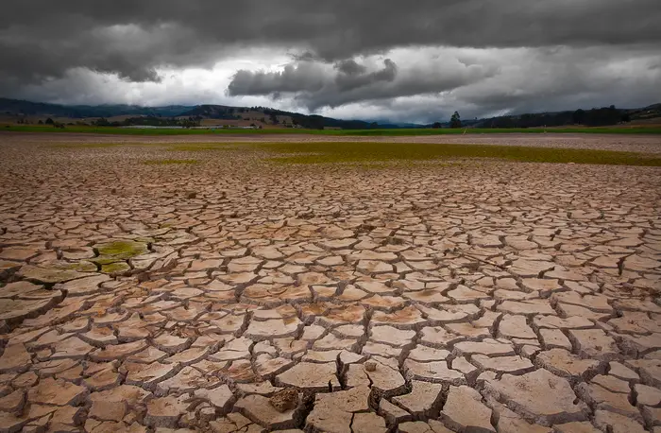
Now that we are finished discussing some prerequisite knowledge of the ancient Maya civilization, our focus will pivot back to The Terminal Classic Period. As mentioned earlier, a multitude of factors contributed to the downfall of the Maya civilization. Our focus will be on the 9th and 10th centuries, as that is when the Maya civilization experienced a significant decline. Our discussion will involve the contributions of military losses, the collapse of trade routes, harsh droughts
Notes:
References:
Image source: Dry section of desert, digital image, accessed March 23, 2023 <https://www.insider.com/maya-civilization-fall-droughts-climate-change-mexico-2016-6>

Slide 17
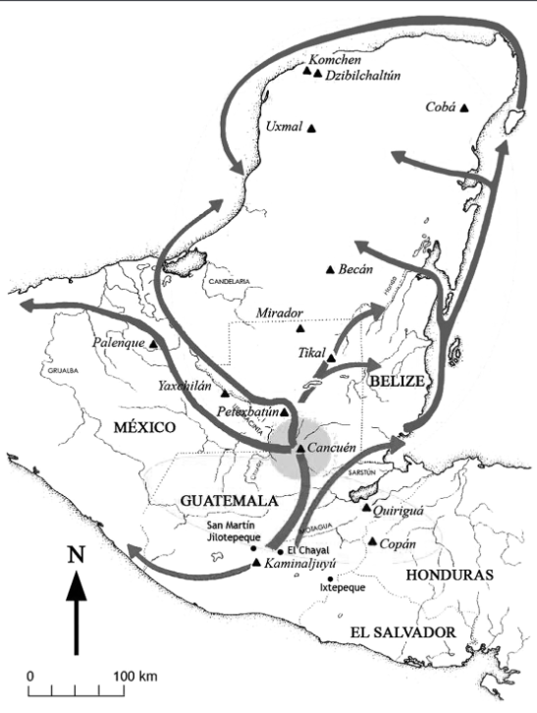
As our first discussion point, we will consider the collapse of trade routes. Building on our earlier discussion about the southern and northern Maya lowlands, archeological evidence in the 20th and 21st centuries uncovered sites of pottery and stone tools in the Maya lowlands, dating back to the Classic Period. Analysis of these tools and sediment revealed trade networks in these areas, where the Maya would exchange exotic goods and obsidian, their main tool material. As seen in the diagram, elaborate trade networks were established over inland water bodies.
Notes:
References:
Zeitlin, R. N. (1984). Archeology and volcanism in Central America. Science, 226, 163+. https://link-gale-com.ezproxy.lakeheadu.ca/apps/doc/A3472821/AONE?u=ocul_lakehead&sid=bookmark- AONE&xid=49347507
Demarest, A. A,. (n.d.) The Collapse of The Classic Maya Kingdoms of the Southwestern Petén: Implications for the End of Classic Maya Civilization. Vanderbilt University. https://www.mesoweb.com/publications/MMS/2_Demarest.pdf

Slide 18
Because the main material resource used by the Maya for tools and power procurement by Maya elites, researchers at the University of Illinois traced the movement of obsidian through sediment analysis. They discovered the trade of obsidian and other materials declined as trade routes were shifted from inland river networks to coastal networks. As inland trade centers decreased, the reliance on coastal trade networks increased, depriving many key Maya inland cities and sites of needed resources.
Notes:
References:
Zeitlin, R. N. (1984). Archeology and volcanism in Central America. Science, 226, 163+. https://link-gale-com.ezproxy.lakeheadu.ca/apps/doc/A3472821/AONE?u=ocul_lakehead&sid=bookmark- AONE&xid=49347507
Demarest, A. A,. (n.d.). The Collapse of The Classic Maya Kingdoms of the Southwestern Petén: Implications for the End of Classic Maya Civilization. Vanderbilt University. https://www.mesoweb.com/publications/MMS/2_Demarest.pdf
(2018, Jan 30). Shifting trade routes may have led to Maya decline. Belize Travel Blog. https://belize-travel-blog.chaacreek.com/2012/05/shifting-trade-routes-may-have-led-to-maya-decline/

Slide 19
When augmented by unfavourable climate conditions causing a linear decrease in both precipitation and available natural resources, inland cities and sites were starved of the materials they needed. Maya rulers and priests used obsidian to procure power and respect, often establishing relationships by sending gifts of obsidian and believed by many to
Notes:
References:
Zeitlin, R. N. (1984). Archeology and volcanism in Central America. Science, 226, 163+. https://link-gale-com.ezproxy.lakeheadu.ca/apps/doc/A3472821/AONE?u=ocul_lakehead&sid=bookmark- AONE&xid=49347507
Demarest, A. A,. (n.d.). The Collapse of The Classic Maya Kingdoms of the Southwestern Petén: Implications for the End of Classic Maya Civilization. Vanderbilt University. https://www.mesoweb.com/publications/MMS/2_Demarest.pdf
(2018, Jan 30). Shifting trade routes may have led to Maya decline. Belize Travel Blog. https://belize-travel-blog.chaacreek.com/2012/05/shifting-trade-routes-may-have-led-to-maya-decline/

Slide 20
Because the main material resource used by the Maya for tools and power procurement by Maya elites, researchers at the University of Illinois traced the movement of obsidian through Mesoamerica during the 8th, 9th, and 10th centuries. They discovered the trade of obsidian and other materials declined as trade routes were shifted from inland river networks to coastal networks. As inland trade centers decreased, the reliance on coastal trade networks increased, depriving many key Maya inland cities and sites of resources.
Notes:
References:
Zeitlin, R. N. (1984). Archeology and volcanism in Central America. Science, 226, 163+. https://link-gale-com.ezproxy.lakeheadu.ca/apps/doc/A3472821/AONE?u=ocul_lakehead&sid=bookmark- AONE&xid=49347507
Demarest, A. A,. (n.d.). The Collapse of The Classic Maya Kingdoms of the Southwestern Petén: Implications for the End of Classic Maya Civilization. Vanderbilt University. https://www.mesoweb.com/publications/MMS/2_Demarest.pdf
(2018, Jan 30). Shifting trade routes may have led to Maya decline. Belize Travel Blog. https://belize-travel-blog.chaacreek.com/2012/05/shifting-trade-routes-may-have-led-to-maya-decline/

Slide 21
Continuing our discussion, we will dissect how warfare was a significant contributing factor. By the 8th century, the Maya developed a highly sophisticated civilization with advanced systems of agriculture, writing, art, and literature. Mostly, these systems were rooted in powerful city-states such as Tikal (Cyan), Calakmul (Black), and Palenque (Purple), all of which competed for control of resources and territory. However, archeological evidence suggests conflicts such as the above may have a deeper meaning.
Notes:
References:

Slide 22
In late 20th-century and modern-day 21st-century studies, new archeological evidence has emerged suggesting that both internal and external military losses, revealed by evidence of mass killings, defensive structures, and burned buildings, suggest repeated military actions decimated the surrounding area. Additionally, studies have found clues of the Maya monarchy system breaking down, causing political instability and infighting as powerful rulers, nobles, and priests were disposed of.
Notes:
References:

Slide 23
Archeological excavations conducted by researchers at the site of Dos Pilas (Red), located in modern-day Guatemala (Purple), revealed a series of hidden defense structures, including walls, towers, and moats, in various states of decay. Thus, the researchers proposed that the site was under attack by some foreign invaders. In addition, further evidence of mass killings and other acts of violence suggests the site was eventually overrun by enemy forces.
Notes:
References:

Slide 24
At other Maya sites, including Tikal and Copan, similar archeological data has been compiled. At Tikal specifically, researchers found evidence of burned buildings and mass killings, facing the same situation as Dos Pilas. Copan has much more sinister data, however, with human remains found in a mass grave site. As these cities and sites were attacked and occupied by foreign invaders, many were forced to flee or were killed, leading to the mass abandonment of many inland and coastal sites and cities.
Notes:
References:

Slide 25
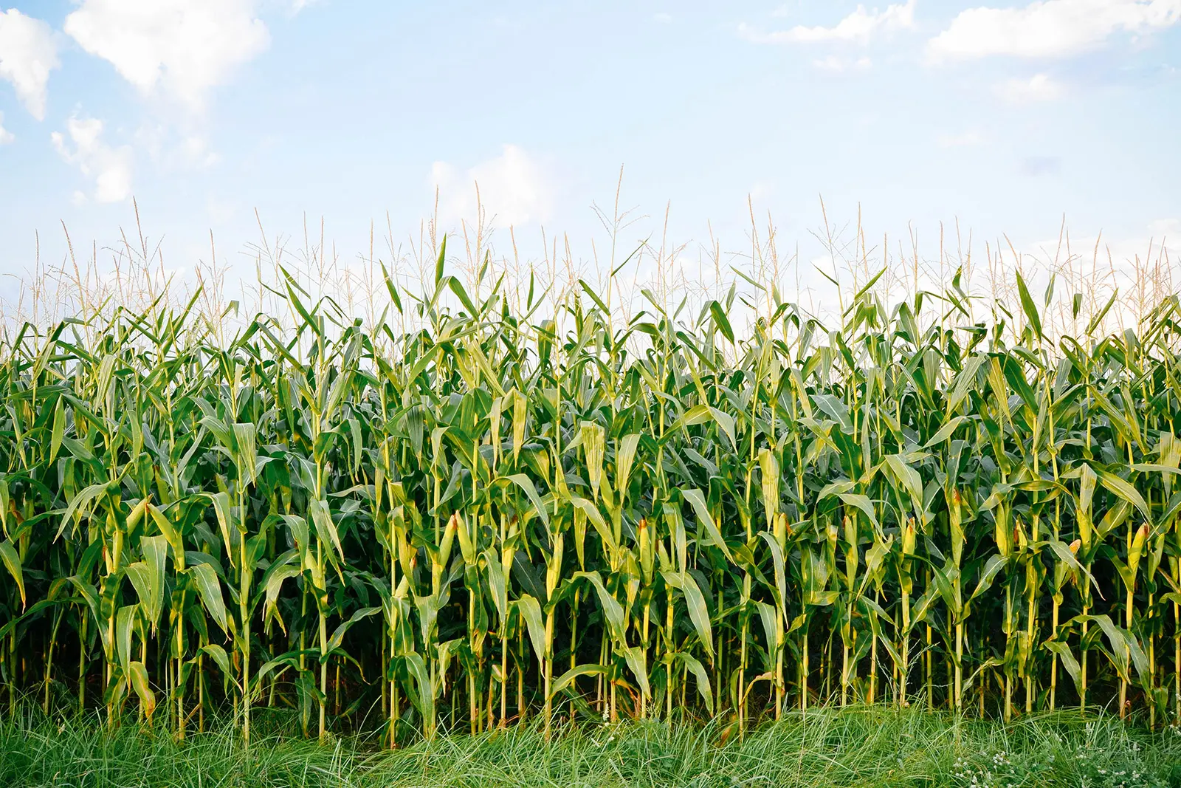
As our last discussion point, we will switch our focus to how poor climate conditions, particularly harsh droughts in Mesoamerica in the 9th and 10th centuries, were the most significant factor in the collapse of the Maya civilization. Shown here on the slide is a hint as to what was particularly devastating for the Maya civilization. However, we must first discuss the agricultural practices of the Maya to fully appreciate the upcoming slides.
Notes:
References:
Image of Maize: https://www.gardenbetty.com/corn-vs-maize/

Slide 26
Because Traditional Maya agriculture is highly adapted to the seasonal rhythms of regional precipitation,
Notes:
References:
Image of Maize: https://www.gardenbetty.com/corn-vs-maize/

